Slide 1

Mirrored Improved Howland Current Source With Wien Bridge-Based Oscillator
Igor Grossi, Eng. Redes de Comunicação
Lukas Lorenz, Eng. Mecatrônica
Rogerio Barbosa Eng. Elétrica

Slide 2
Topics
- Objectives​
- Simulation​s
- Implementation​
- Results ( Ou​​tput)
-Project Cost​
-Conclusions

Slide 3
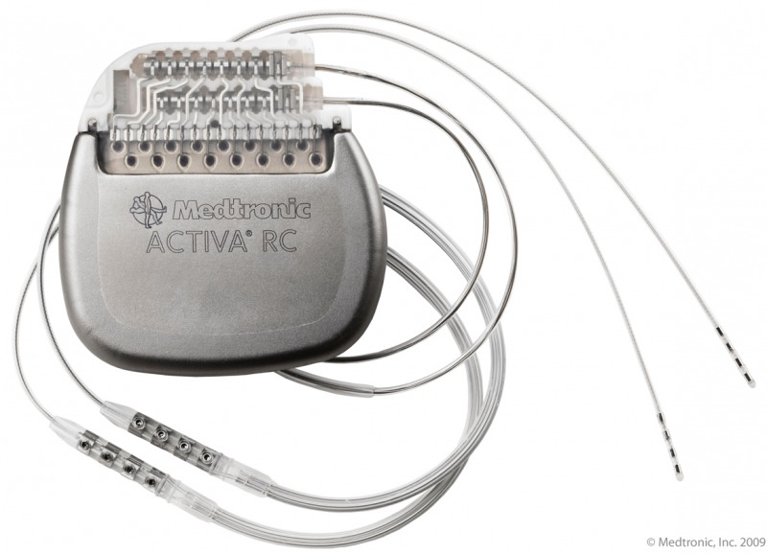
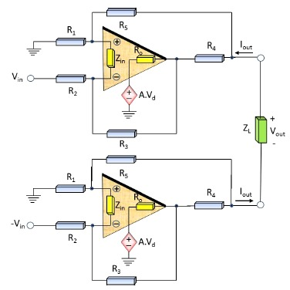
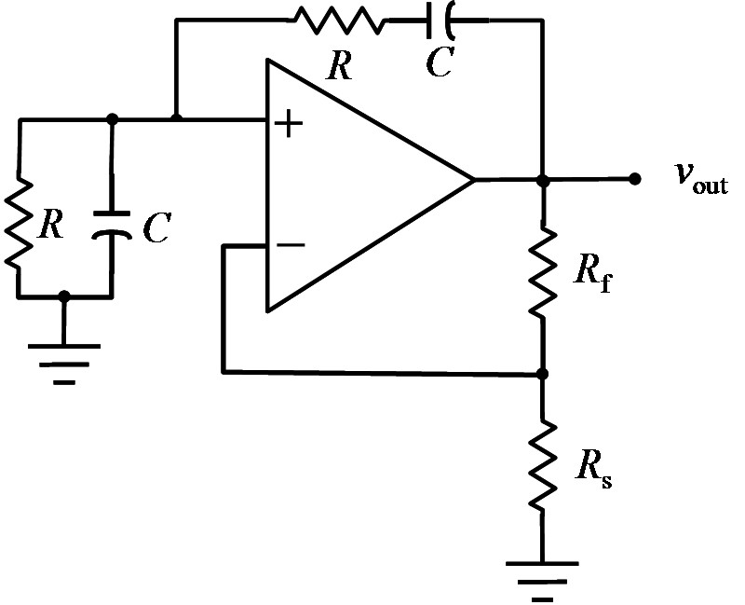
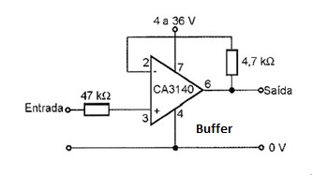
Objectives
Medical equipments;
Voltage-controlled current source;

Slide 4
Wien Oscillator
Wien oscillator’s schematic

Slide 5
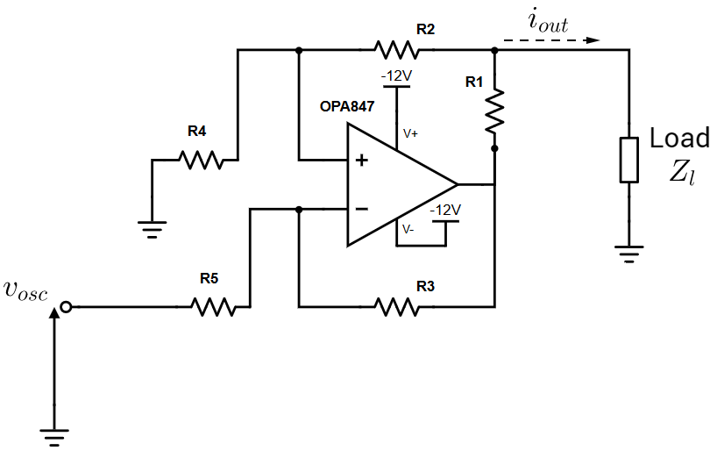
Howland Current Source
Howland’s circuit schematic
Single Howland’s schematic

Slide 6
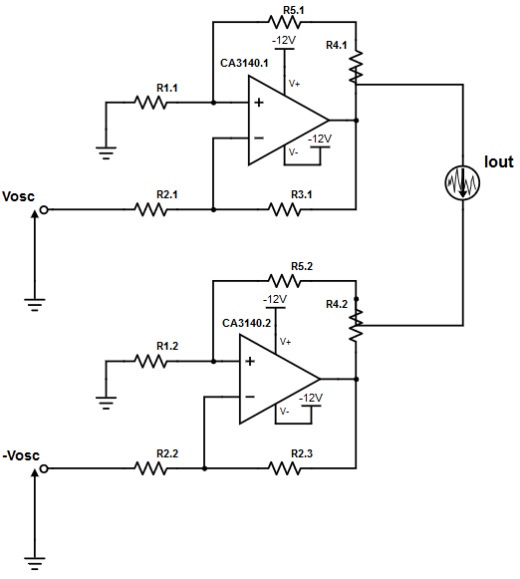
Mirrored Howland Source
Mirrored Howland’s schematic

Slide 7
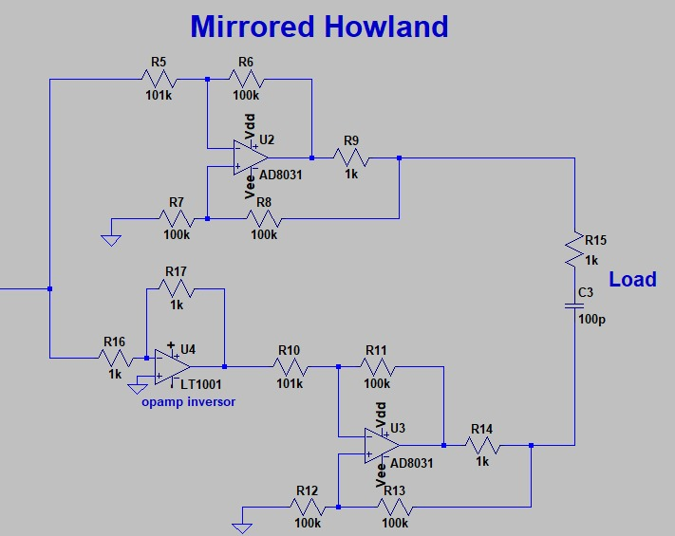
Simulations
Mirrored Howland’s schematic

Slide 8
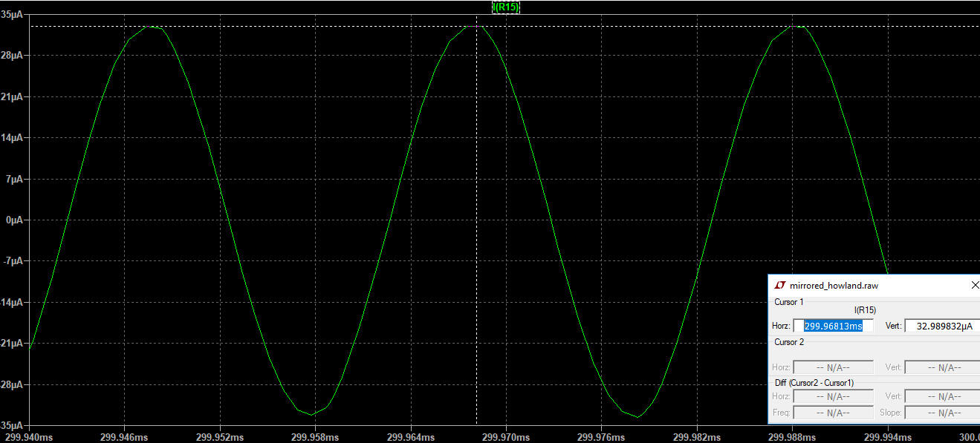
Simulations
R=1 kOhm

Slide 9
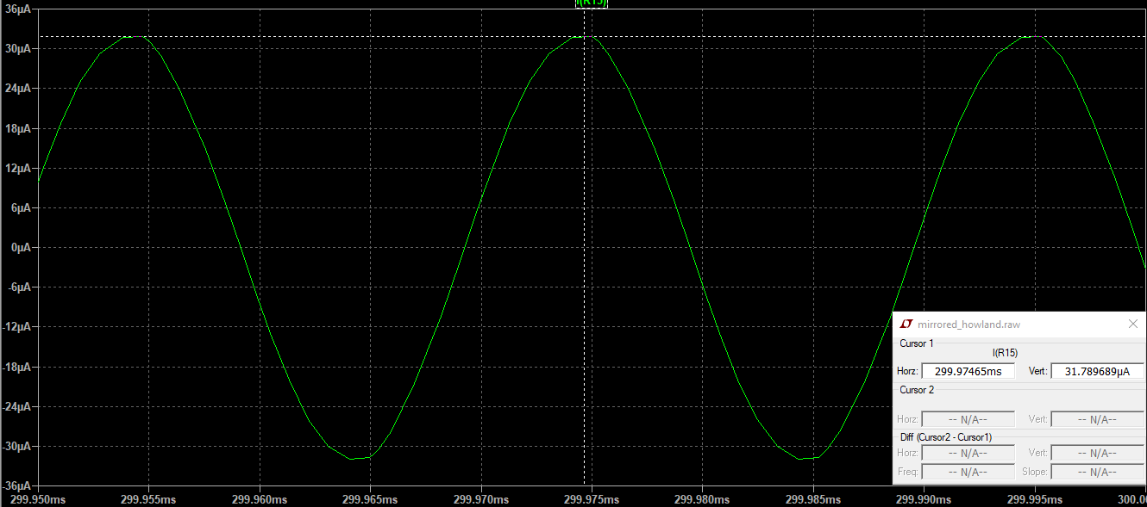
Simulations
R= 2 kOhm

Slide 10
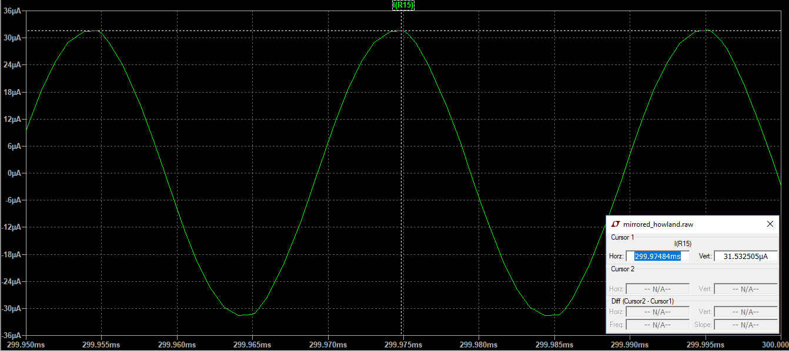
Simulations
R= 3 kOhm

Slide 11
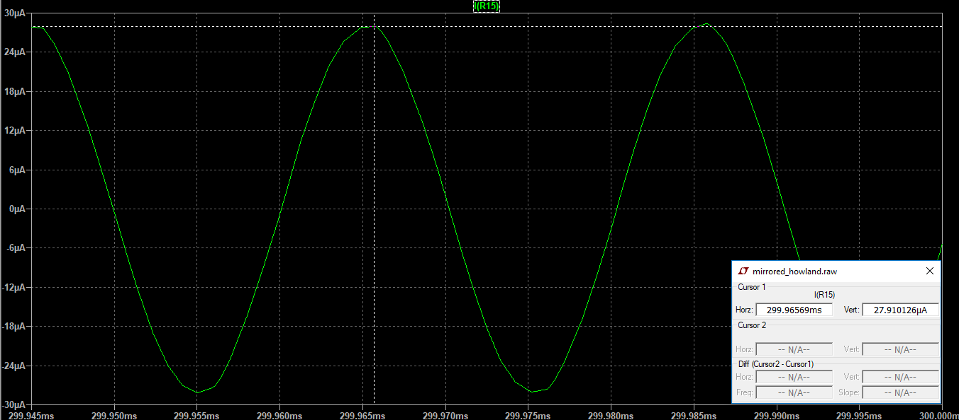
Simulations
R= 4 kOhm

Slide 12
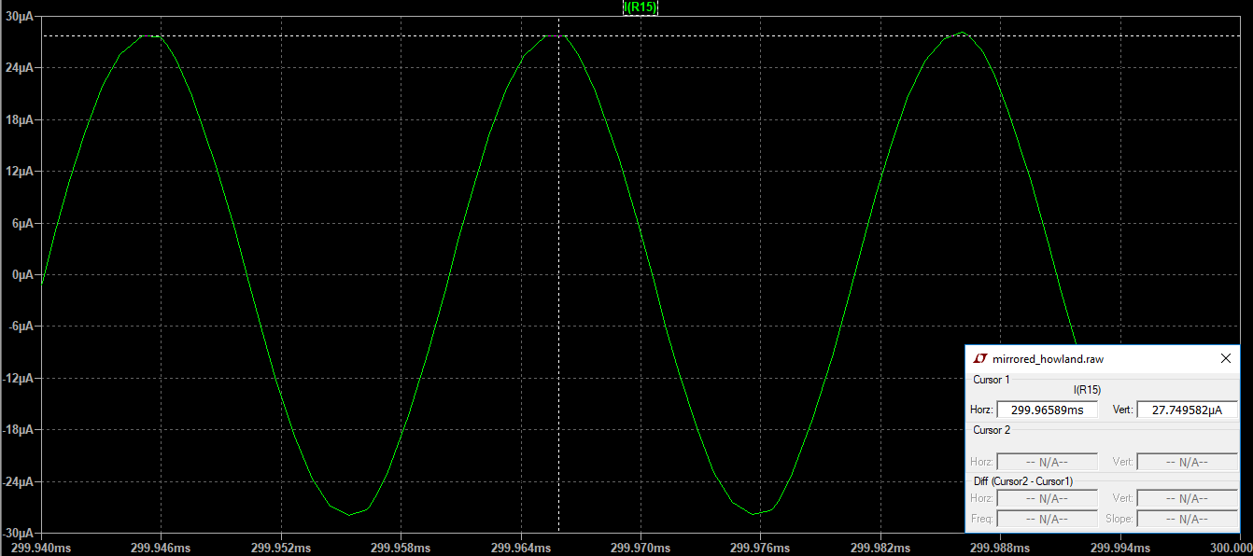
Simulations
R= 5kOhm

Slide 13
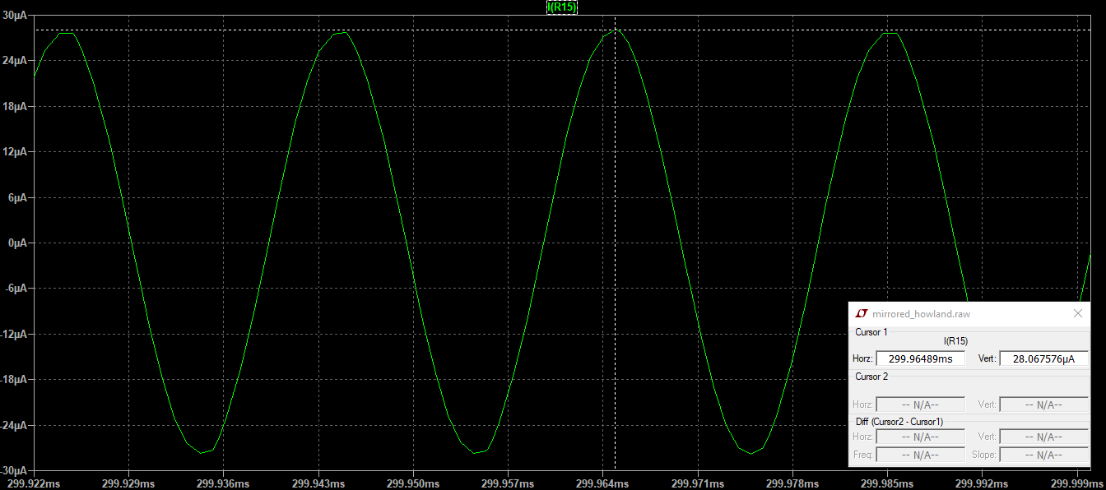
Simulations
R= 6 kOhm

Slide 14
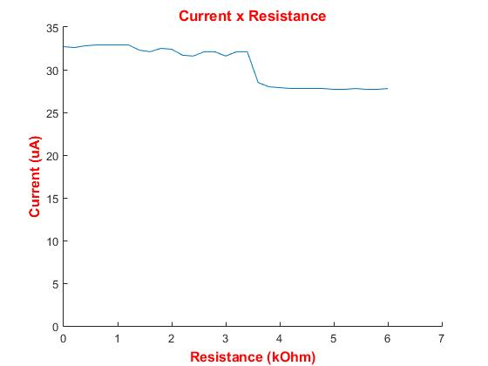
Simulations

Slide 15
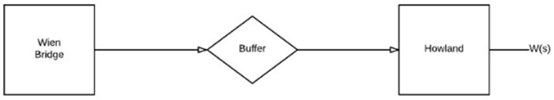
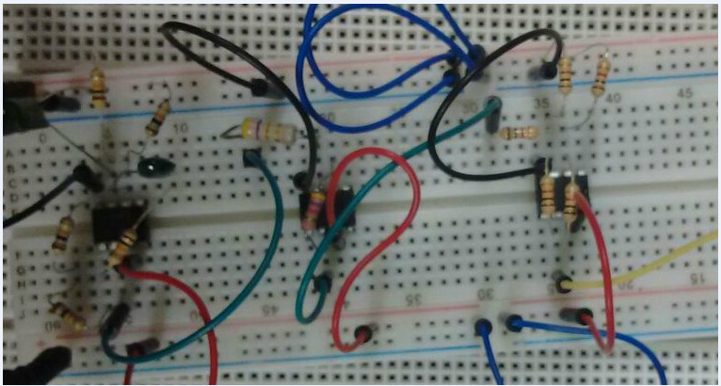
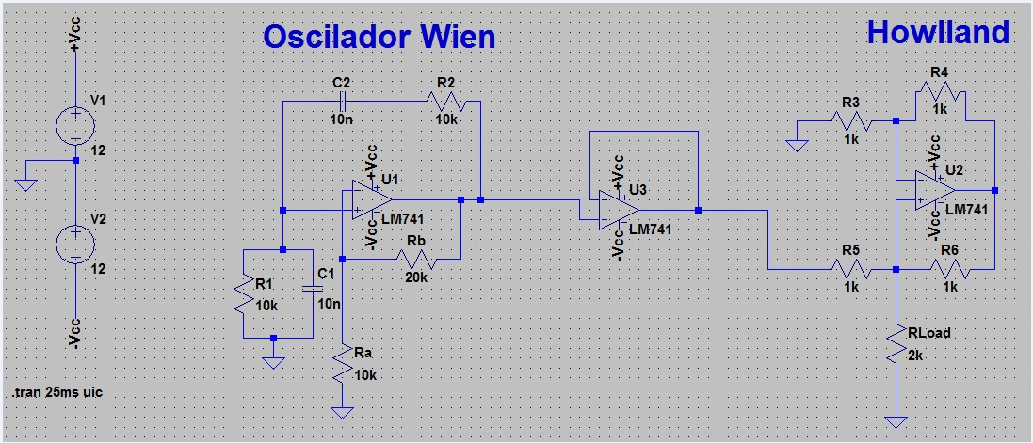
Schematic Project

Slide 16
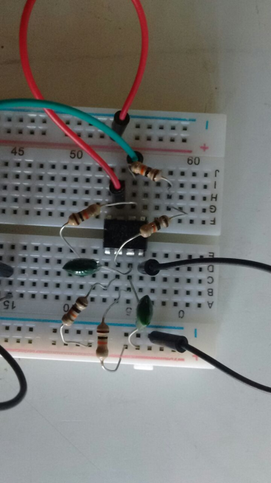
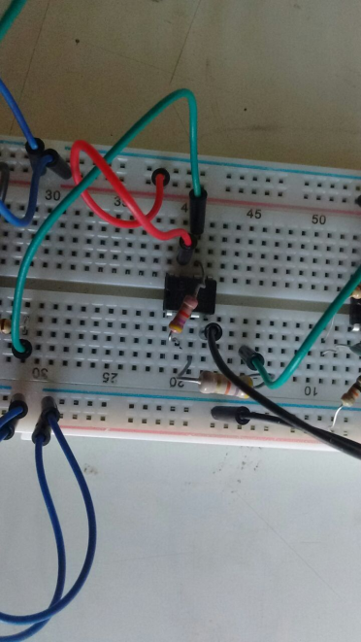
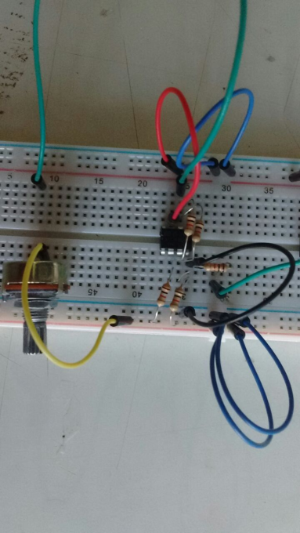
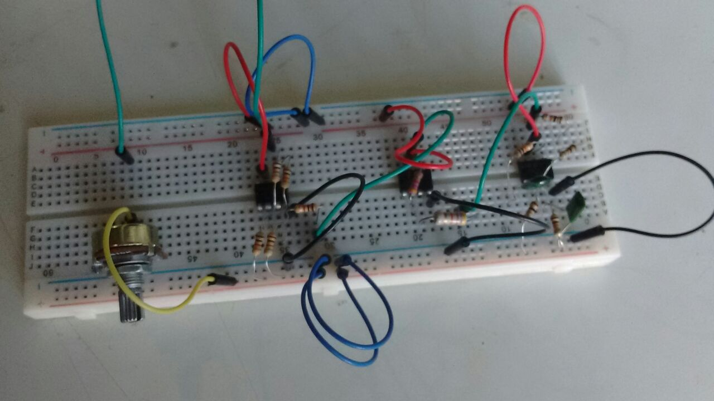
Implementation​
Wien Bridge
Buffer
Howland

Slide 17
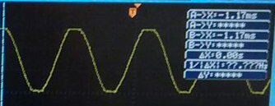
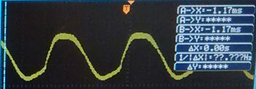
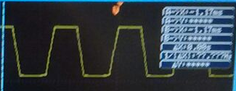
Output
Wien Bridge
Howland
Buffer

Slide 18
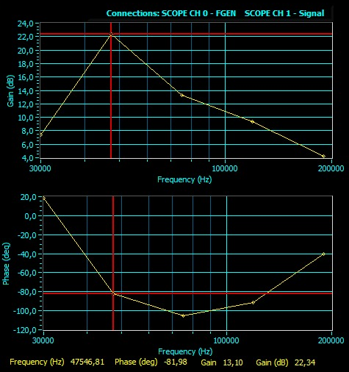
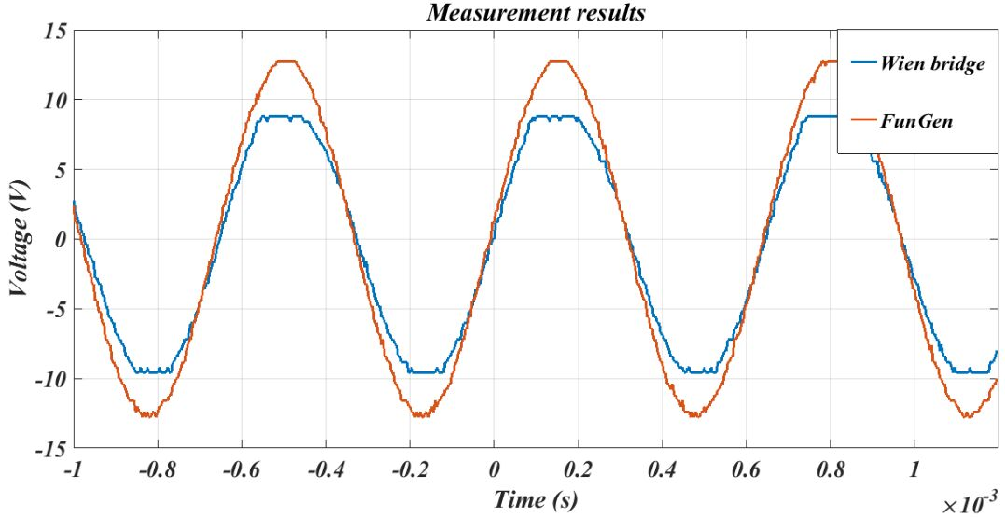
Results
Bode plot

Slide 19
Project cost
It was used to get all the results the following tools
LTspice;
Function generator;
Oscilloscope;
Multimeter;
NI ELVIS II;
To implement the circuit we used:
Protoboard;
Integrated circuits LM749 - Wien's bridge and Howland circuit;
Integrated circuit CA 3140 - Buffer;
10nF capacitor;
1k ohms resistor;
47k ohms resistor;
4.7k ohms resistor;
10k ohms resistor;
20k ohms resistor.
SUM = R$22,00

Slide 20
Conclusion
 | Theorical results expected | Simulation | Experimental
Frequency (kHz) | 50 | 50 | 47.546
Voltage (mV) | 20 | 16 | 20
Current (μA) | 300 | 320 | 363

Slide 21
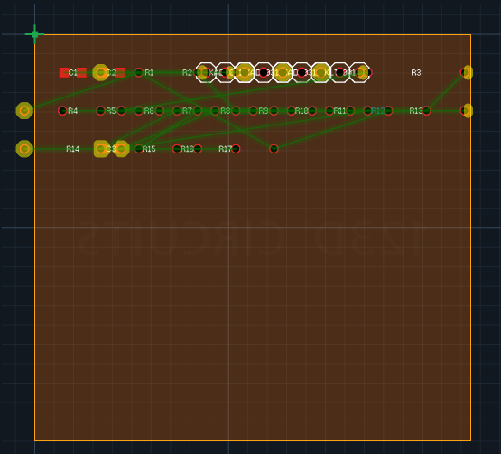
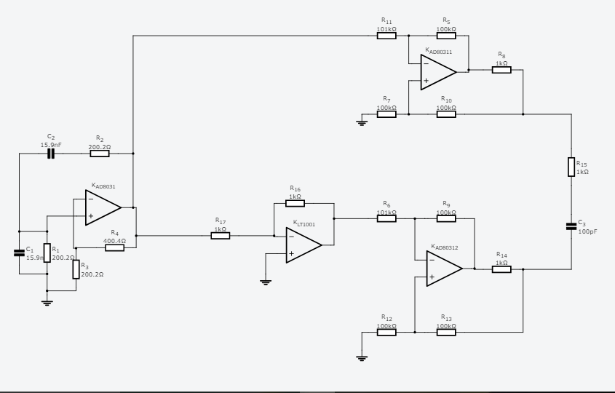
Conclusion
PCB
Circuit schematic

Slide 22
References
Video used to the simulation analysis:
https://www.youtube.com/watch?v=MdZHkpkUrGw
https://www.youtube.com/watch?v=cXmomjBScGI;
https://www.youtube.com/watch?v=aJAZHPqEUKU
http://www.qrparci.org/wa0itp/chap10.pdf
http://www.eecs.yorku.ca/course_archive/2007-08/W/3215/labs%20documentation/dds.pdf
The other references are on the github group page.

